Slide 1

Analyzing Median House Prices and School Ratings for Scarborough Canada
IBM Data Science Capstone Project

Slide 2
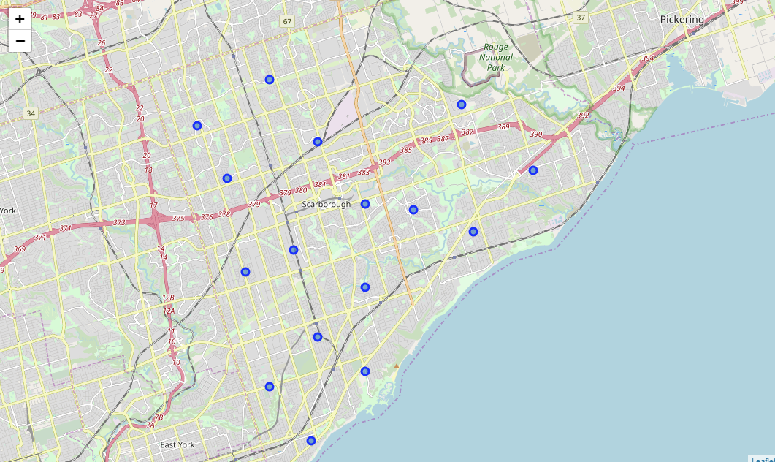
Scarborough Canada

Slide 3
Project Description
The projects aim to create an analysis of features for a neighborhood as a comparative analysis between neighborhoods. The features include median house price and school ratings. This would help people to get awareness of the places before moving to new state, city or place for their work or to start a new life.
The aim of this Project is to help people explore different possibilities and take a better decision on choosing the best neighborhood out of many neighborhoods in Scarborough city based on the distribution of various facilities in and around that neighborhood.

Slide 4
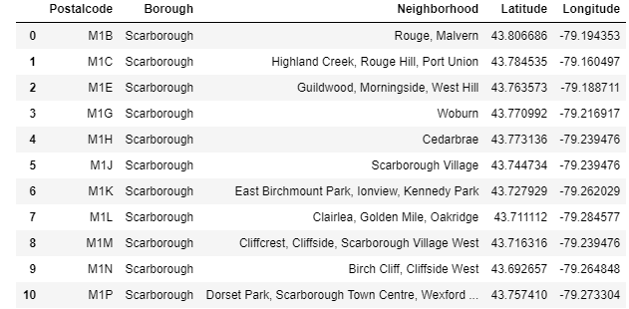
Required data
Longitude and Latitude Data
Geo location information from Foursquare
Zip codes of Scarbourough in Toronto

Slide 5
Foursquare API
Connection the Foursquare and Retreiving location data fro each venue in every Neighborhood
After finding the list of neighborhoods, we then connect to the Foursquare API to gather information about venues inside each and every neighborhood. For each neighborhood, we have chosen the radius to be 500 meter

Slide 6
Data processing
Processing the collected data and creata datafreme for all the Venues in Scaborough
Data gathered
Performing data processing
Our main feature is the category of that venue. After this stage, the column "Venue's Category" will be One-hot encoded and different venues will have different feature-columns.

Slide 7
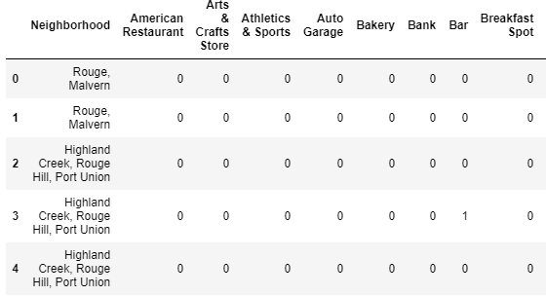
Dataframe creation

Slide 8
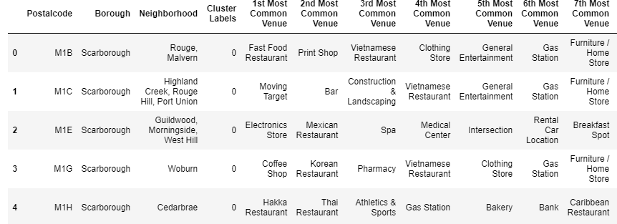
Find common venues
Find common venues and create 3 clusters on the neighborhood by using k-means

Slide 9
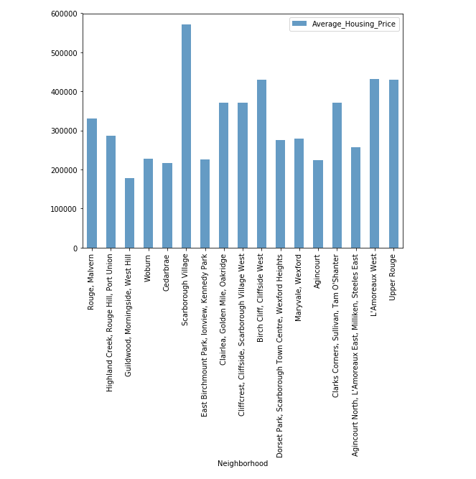
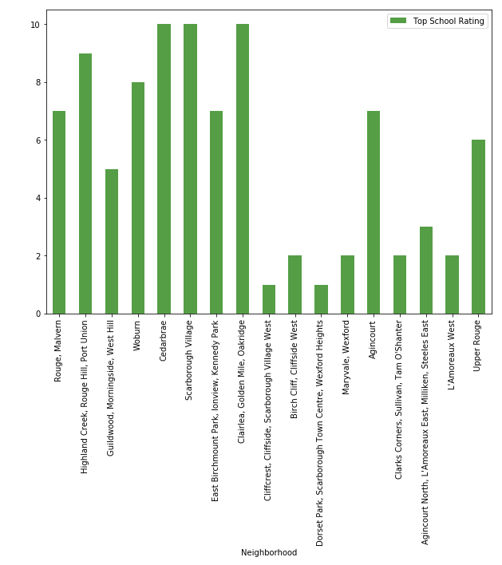
Median house prices & Scool ratings

Slide 10
Conlusion
In this project, through a k-means cluster algorithm we separate the neighborhood into 03 clusters, which have similar neighborhoods around them. Using the charts above decision loving to a particular neighborhood based on average house prices and school rating can be made.

Slide 11
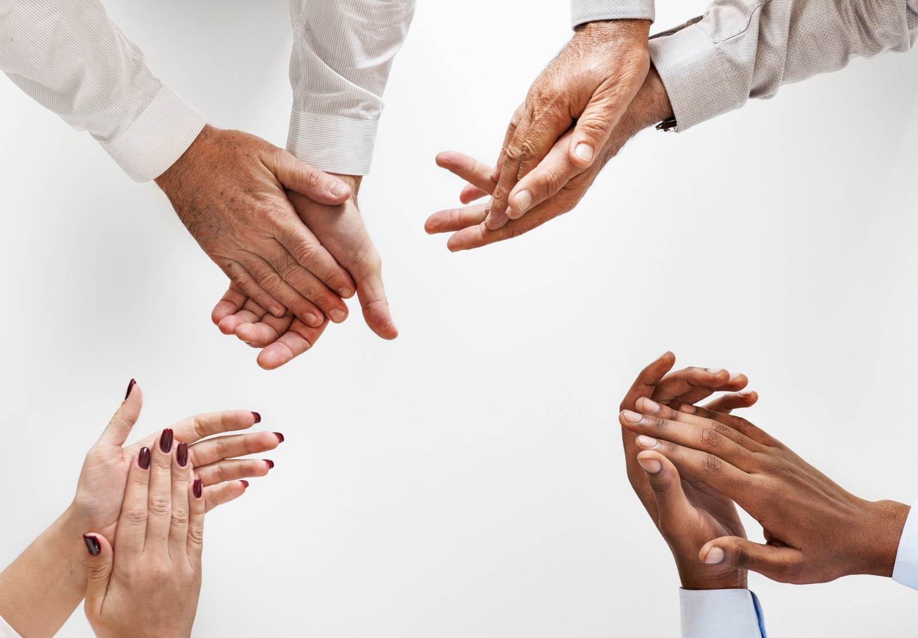

Thank You
Norbert Csejtey

